Slide 1

Course Code:- CSE-499 (B)
Presentation On
“Design and Implementation of a Smart Gardening System Using ESP 8266”
Presented By
Supervised By
Sampa Rani Sarker Mst. Arjina Khatun
ID No: 01321208002 ID No: 01321208011
Batch: 13th Batch: 13th
MD. PALASH TAI
Department Head
Department of CSE
PUB

Slide 2
Presentation Outline
Introduction
Objective
Methodology
Hardware Components
ESP-8266
Soil Moisture Sensor
DHT-11 Sensor
Block Diagram
Advantages
Limitation
Future Scopes
Conclusion
1

Slide 3
Introduction
The Smart Gardening System is an innovative solution aimed at automating and optimizing garden maintenance using modern IoT technology.
It integrates advanced components to monitor environmental conditions, automate irrigation, and enhance plant care efficiency.
This system provides multiple benefits, including water conservation, improved plant health, and reduced manual effort.
This project primarily focuses on the design and implementation of a robust control system.
In this project, I utilize an ESP8266 module, a relay module, a soil moisture sensor, a DHT11 sensor, a water pump, and other essential components.
2

Slide 4
Objective
Automate garden maintenance using IoT technology for efficiency and convenience.
Optimize water conservation by utilizing real-time soil moisture and environmental data.
Reduce manual effort through automated irrigation and monitoring.
Improve plant health by maintaining optimal temperature, humidity, and soil moisture levels.
Enable remote monitoring and control for efficient garden management from anywhere.
VISION
MISSION
3

Slide 5
Methodology
The Smart Gardening System utilizes IoT technology to efficiently manage plant care, optimize irrigation, and monitor environmental conditions.
System Design: Developed using ESP8266 for smart control.
Sensor Selection: Uses Soil Moisture Sensor & DHT11 for data collection.
Automated Gardening: Relay module controls the water pump based on moisture levels.
Monitoring & Feedback: Provides real-time updates via Wi-Fi for remote access.
4

Slide 6
Hardware Component
ESP-8266.
Soil Moisture Sensor.
DHT-11 Sensor.
Adapter.
Water Pump.
Water Container.
Switch.
Connecting Wires.
DC Socket.
Relay Module.
5

Slide 7
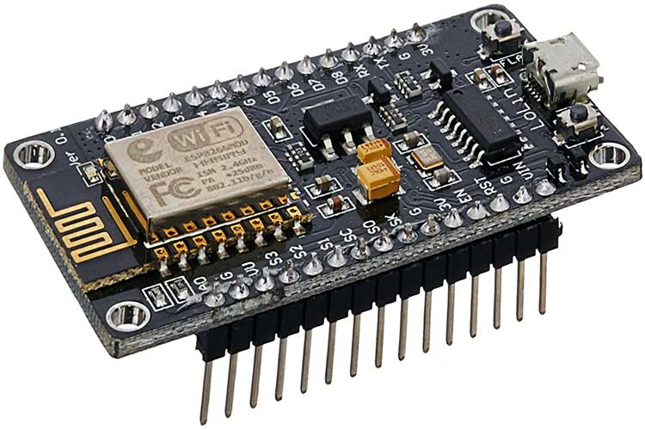
ESP-8266
NodeMCU (ESP8266) is an open-source IoT platform with built-in Wi-Fi, CPU, and RAM. It supports Lua and C programming via Arduino IDE and has 10 GPIO pins for interfacing.
Specification
Microprocessor: 32-bit Tensilica L106
ROM: 64 KB
SRAM: 96 KB
Flash Memory: Supports up to 16MB
Wi-Fi: 802.11 b/g/n with WPA/WPA2 security
Operating Voltage: 3.3V
6

Slide 8
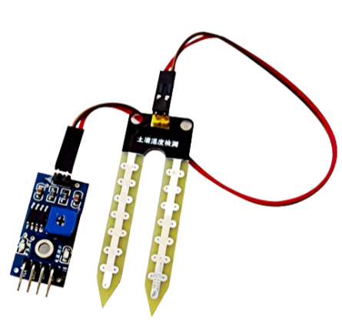
Soil Moisture Sensor
The soil moisture sensor is used to calibrate the water or moisture content of the soil. Depending upon when the soil has more water content or less water content, the output of the module is at a low level and high level respectively.
Specification
Working voltage: 5V
Working current: <20 mA
Interface: Analog
Working Temperature: 10°C~30°C
7

Slide 9
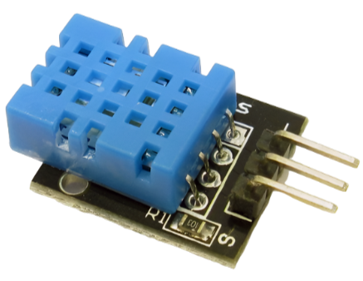
DHT-11 Sensor
The dht11 sensor, a combination of temperature and humidity sensor generally gives digital or analog output. This technology is quite dependable and gives accurate results for a longer period of time. Specification
Operating Voltage: 3.5V to 5.5V.
Operating current: 0.3mA (measuring) 60uA (standby).
Output: Serial data.
Temperature Range: 0°C to 50°C.
Humidity Range: 20% to 90%.
Resolution: Temperature and Humidity both are 16-bit.
Accuracy: ±1°C and ±1%.
8

Slide 10
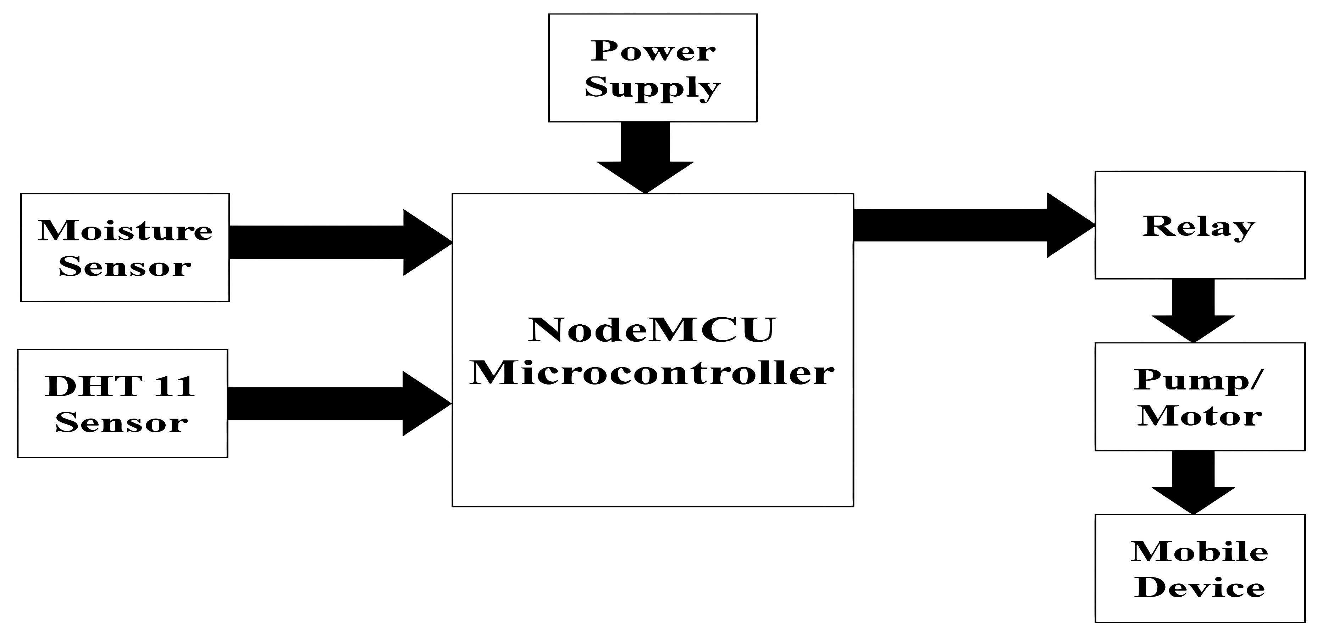
Block Diagram
9

Slide 11
Advantage
Increase in productivity
Reduce water consumption.
No manpower required.
It saves the energy.
It can be controlled from any where in the world.
Easy to use.
Low price
10

Slide 12
Limitation
Internet Dependency – Requires a stable Wi-Fi connection for remote access.
Sensor Accuracy – Low-cost sensors may provide less precise data.
Power Dependency – Needs a continuous power supply for uninterrupted Operation.
Complex Setup – Installation requires technical knowledge in IoT and programming.
11

Slide 13
Future Scope
Providing the new technology for farmers to improve the quality of irrigation system.
Also helps to those farmers whom do not have sufficient water for farming.
This is very useful as it reduces manual work of the farmer
12

Slide 14
Conclusion
This Smart Gardening System using ESP8266 makes plant care more efficient by automating irrigation, reducing time and effort while ensuring healthier plant growth. It eliminates the need for manual watering by automatically controlling the irrigation system based on real-time sensor data. This project can be further extended for greenhouse automation, where minimal manual supervision is required.
13

Slide 15
THANK YOU
14

